Slide 1
EMTH403
Mathematical Foundation for Computer Science

Slide 2
Lecture Outcomes
understand what truth value of the universal quantification.
express the compound proposition with universal quantification in English.
understand how to write compound proposition with universal quantification using disjunctions, conjunctions, and negations

Slide 3
Quantifiers
Quantification expresses the extent to which a predicate is true over a range of elements.
In English, the words all, some, many, none, and few are used in quantifications.

Slide 4
We will focus on two types of quantification here
  Universal Quantification
  Existential Quantification

Slide 5
Quantifiers
Universal quantification, which tells us that a predicate is true for every element under consideration.
Existential quantification, which tells us that there is one or more element under consideration for which the predicate is true.

Slide 6
Quantifiers
The area of logic that deals with predicates and quantifiers is called the Predicate Calculus.

Slide 7
Quantifiers
Many mathematical statements assert that a property is true for all values of a variable in a particular domain, called the domain of discourse (or the universe of discourse), often just referred to as the domain.
The meaning of the universal quantification of P(x) changes when we change the domain.

Slide 8
Quantifiers
The domain must always be specified when a Universal quantifier is used.
Without it, the universal quantification of a statement is not defined.

Slide 9
Universal Quantifier
The universal quantification of P(x) is the statement.
  “P(x) for all values of x in the domain.”
The notation ∀xP(x) denotes the universal quantification of P(x).
Here ∀ is called the universal quantifier.

Slide 10
Quantifiers
Universal quantification ∀xP(x) is the same as the conjunction P(x₁) ∧ P(x₂) ∧ · · · ∧ P(x_{n}), because this conjunction is true if and only if P(x₁), P(x₂), . . . , P (x_{n}) are all true.

Slide 11
Universal Quantifier – Counter Example
We read ∀xP(x) as “for all xP(x)” or “for every xP(x).”
An element for which P(x) is false is called a counterexample of ∀xP(x) (Will be discussed in
Example - 3)

Slide 12
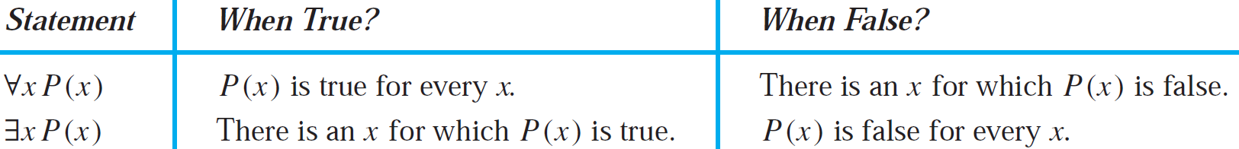
Universal Quantifier
The meaning of the universal quantifier is summarized in the first row of Table 1.

Slide 13
Universal Quantifier – Example - 1
Ques:- What does the statement ∀xN(x) mean if N(x) is “Computer x is connected to the network” and the domain consists of all computers on campus?
Ans:- The statement ∀xN(x) means that for every computer x on campus, that computer x is connected to the network. This statement can be expressed in English as “Every computer on campus is connected to the network.”

Slide 14
Universal Quantifier – Example - 2
Ques:- Let P(x) be the statement “x + 1 > x.” What is the truth value of the quantification ∀xP(x), where the domain consists of all real numbers?
Ans:- Because P(x) is true for all real numbers x, the quantification ∀xP(x) is true.

Slide 15
Universal Quantifier – Example - 3
Ques:- Let Q(x) be the statement “x < 2.” What is the truth value of the quantification ∀xQ(x), where the domain consists of all real numbers?
Ans:- Q(x) is not true for every real number x, because, for instance, Q(3) is false.
That is, x = 3 is a counterexample for the statement ∀xQ(x). Thus ∀xQ(x) is false.

Slide 16
Universal Quantifier – Example - 4
Ques:- Suppose that P(x) is “x² > 0.” To show that the statement ∀xP(x) is false where the universe of discourse consists of all integers, we give a counterexample.
Ans:- We see that x = 0 is a counterexample because x² = 0 when x = 0, so that x² is not greater than 0 when x = 0.

Slide 17
Universal Quantifier – Example - 5
Ques:- What is the truth value of ∀xP(x), where P(x) is the statement “x² < 10” and the domain consists of the positive integers not exceeding 4?
Ans:- The statement ∀xP(x) is the same as the conjunction P(1) ∧ P(2) ∧ P(3) ∧ P(4), because the domain consists of the integers 1, 2, 3, and 4. Because P(4), which is the statement “4² < 10,” is false, it follows that ∀xP(x) is false.

Slide 18
Universal Quantifier – Example - 5
Ques:- What is the truth value of ∀x(x² ≥ x) if the domain consists of all real numbers? What is the truth value of this statement if the domain consists of all integers?
Ans:- The universal quantification ∀x(x² ≥ x), where the domain consists of all real numbers, is false. For example, ( 1/2 )² ≥ 1/2 .

Slide 19
Universal Quantifier – Example - 5
Ques:- What is the truth value of ∀x(x² ≥ x) if the domain consists of all real numbers? What is the truth value of this statement if the domain consists of all integers?
Ans:- Note that x² ≥ x if and only if x² − x = x(x − 1) ≥ 0. Consequently, x² ≥ x if and only if x ≤ 0 or x ≥ 1. It follows that ∀x(x² ≥ x) is false if the domain consists of all real numbers (because the inequality is false for all real numbers x with 0 < x < 1).

Slide 20
Universal Quantifier – Example - 5
Ques:- What is the truth value of ∀x(x² ≥ x) if the domain consists of all real numbers? What is the truth value of this statement if the domain consists of all integers?
Ans:- However, if the domain consists of the integers, ∀x(x² ≥ x) is true, because there are no integers x with 0 < x < 1.

Slide 21
Universal Quantifier – Example - 6
Ques:- Determine the truth value of each of the statement ∀n(n + 1 > n) if the domain consists of all integers.
Ans:- Since adding 1 to a number makes it larger, this is true.

Slide 22
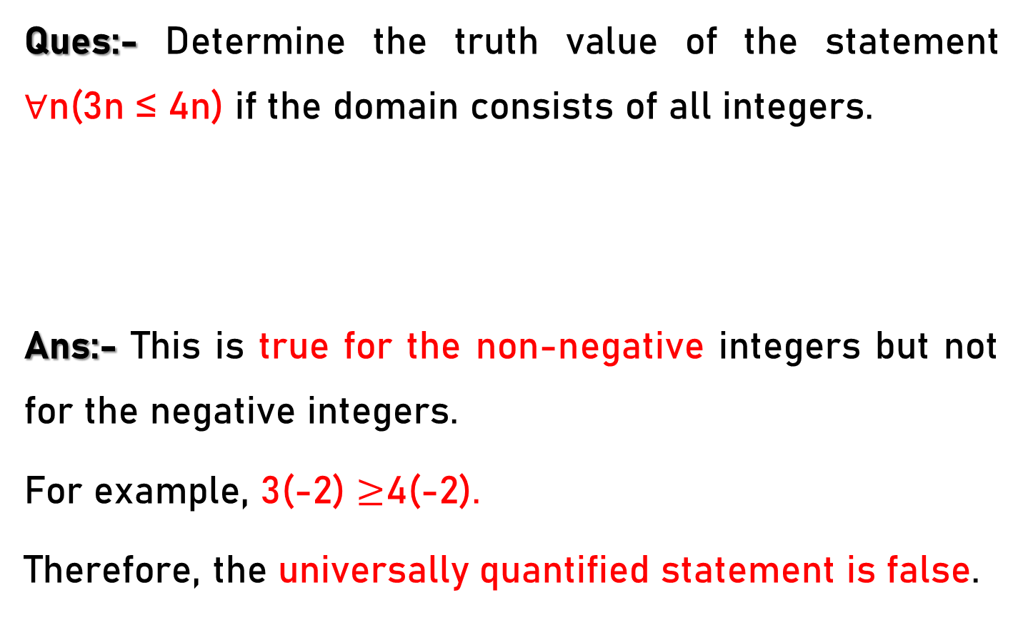
Universal Quantifier – Example - 7
Ques:- Determine the truth value of the statement ∀n(3n ≤ 4n) if the domain consists of all integers.
Ans:- This is true for the non-negative integers but not for the negative integers.
For example, 3(-2) $≥$4(-2).
Therefore, the universally quantified statement is false.

Slide 23
Universal Quantifier – Example - 8
Ques:- Determine the truth value of statement ∀n(n² ≥ 0) if the domain for all variables consists of all integers.
Ans:- This is the well-known fact that the square of a real number cannot be negative.

Slide 24
Universal Quantifier – Example - 9
Ques:- Let P(x) be the statement “x = x²” If the domain consists of the integers, what is the truth value of ∀xP(x)?
Ans:- F (let x = 2 )

Slide 25
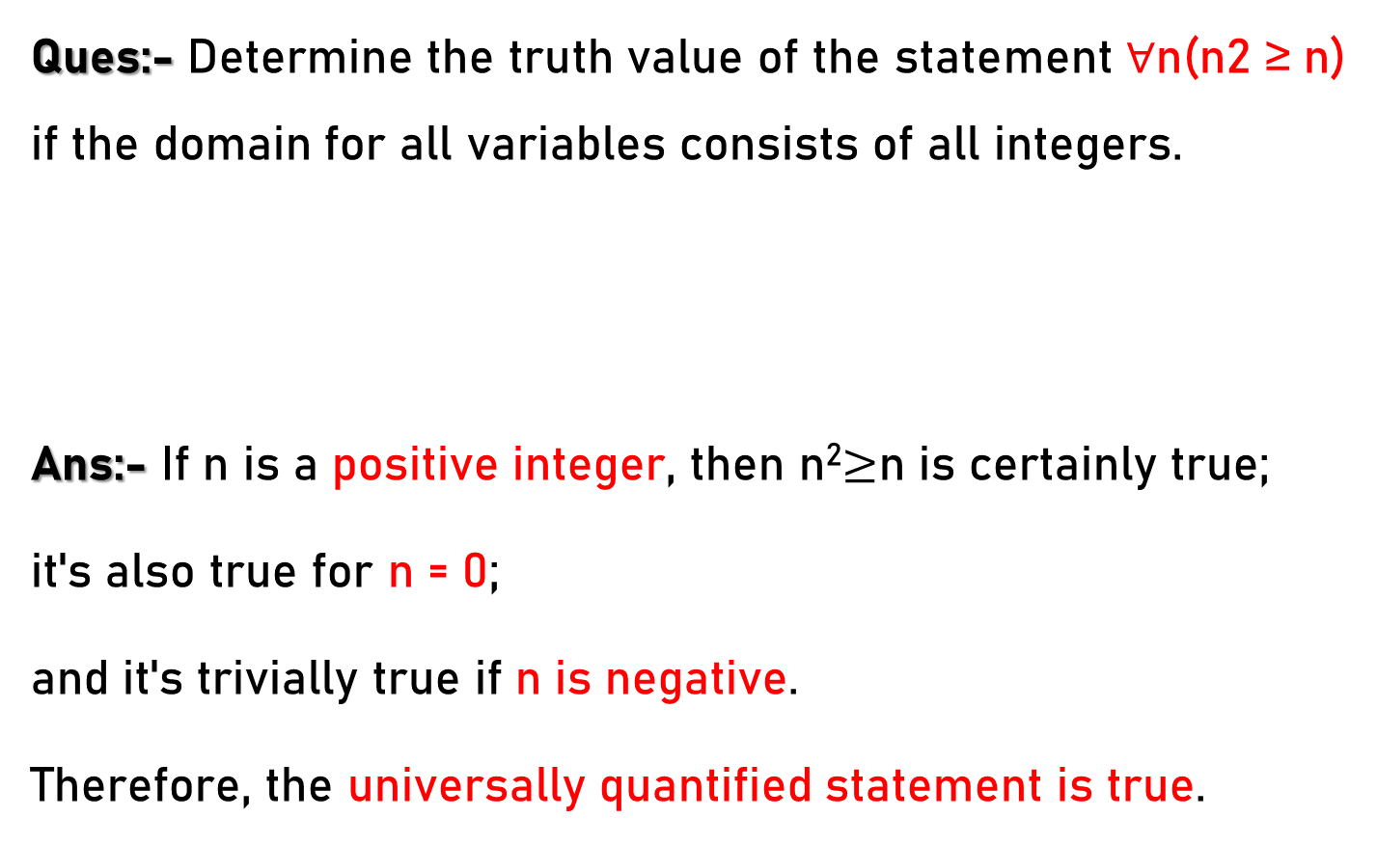
Universal Quantifier – Example - 10
Ques:- Determine the truth value of the statement ∀n(n2 ≥ n) if the domain for all variables consists of all integers.
Ans:- If n is a positive integer, then n²$≥$n is certainly true;
it's also true for n = 0;
and it's trivially true if n is negative.
Therefore, the universally quantified statement is true.

Slide 26
Universal Quantifier – Example - 1
Ques:- Let P(x) be the statement “x spends more than five hours every weekday in class” where the domain for x consists of all students. Express the quantification ∀xP(x) in English.
Ans:- Every student spends more than five hours every weekday in class.

Slide 27
Universal Quantifier – Example - 2
Ques:- Let P(x) be the statement “x spends more than five hours every weekday in class” where the domain for x consists of all students. Express the quantifications
∀x ¬P(x) in English.
Ans:- No student spends more than five hours every weekday in class. (Or, equivalently, every student spends less than or equal to five hours every weekday in class.)

Slide 28
Universal Quantifier – Example - 3
Ques:- Translate the statement ∀x(C(x) → F(x)) into English, where C(x) is “x is a comedian” and F(x) is “x is funny” and the domain consists of all people.
Ans:- This statement is that for every x, if x is a comedian, then x is funny. In English, this is most simply stated, "Every comedian is funny."

Slide 29
Universal Quantifier – Example - 4
Ques:- Translate the statement ∀x(C(x) ∧ F(x)) into English, where C(x) is “x is a comedian” and F(x) is “x is funny” and the domain consists of all people.
Ans:- This statement is that for every x in the domain (universe of discourse), x is a comedian and x is funny.
In English, this is most simply stated, "Every person is a funny comedian."

Slide 30
Universal Quantifier – Example - 1
Ques:- Let P(x) be the statement “x can speak Russian” and let Q(x) be the statement “x knows the computer language C++.” Express the sentence “Every student at your school either can speak Russian or knows C++” in terms of P(x), Q(x), quantifiers, and logical connectives. The domain for quantifiers consists of all students at your school.
Ans:- ∀ x(P(x) V Q(x))

Slide 31
Universal Quantifier – Example - 2
Ques:- Let P(x) be the statement “x can speak Russian” and let Q(x) be the statement “x knows the computer language C++.” Express the sentence “Every student at your school either can speak Russian or knows C++” in terms of P(x), Q(x), quantifiers, and logical connectives. The domain for quantifiers consists of all students at your school.
Ans:- ∀x¬(P(x) V Q(x)).

Slide 32
Universal Quantifier – Example - 3
Ques:- Suppose that the domain of the propositional function P(x) consists of the integers 0, 1, 2, 3, and 4. Write out each of the proposition ∀xP(x) using disjunctions, conjunctions, and negations.
Ans:- P(O) ∧ P(1) ∧ P(2) ∧ P(3) ∧ P(4)

Slide 33
Universal Quantifier – Example - 4
Ques:- Suppose that the domain of the propositional function P(x) consists of the integers 0, 1, 2, 3, and 4. Write out the proposition ∀x¬P(x) using disjunctions, conjunctions, and negations.
Ans:- ¬P(O) ∧ ¬P(l) ∧ ¬P(2) ∧ ¬P(3) ∧ ¬P(4)

Slide 34
Universal Quantifier – Example - 5
Ques:- Suppose that the domain of the propositional function P(x) consists of the integers 1, 2, 3, 4, and 5. Express the statement ∀xP(x) without using quantifiers, instead using only negations, disjunctions, and conjunctions.
Ans:- P(l) ∧ P(2) ∧ P(3) ∧ P( 4) ∧ P(5)

Slide 35
Universal Quantifier – Example - 6
Ques:- Suppose that the domain of the propositional function P(x) consists of the integers 0, 1, 2, 3, and 4. Write out the proposition ¬∀xP(x) using disjunctions, conjunctions, and negations.
Ans:- ¬(P(O) ∧ P(l) ∧ P(2) ∧ P(3) ∧ P(4))

Slide 36
Universal Quantifier – Example - 7
Ques:- Suppose that the domain of the propositional function P(x) consists of the integers 1, 2, 3, 4, and 5. Express the statement ¬∀xP(x) without using quantifiers, instead using only negations, disjunctions, and conjunctions.
Ans:- ¬(P(l) ∧ P(2) ∧ P(3) ∧ P(4) ∧ P(5))

Slide 37
Universal Quantifier – Example - 1
Ques:- For the statement “Everyone is studying discrete mathematics.” Find a domain for which the statement is true and a domain for which the statement is false.
Ans:- One would hope that if we take the domain to be the students in your class, then the statement is true. If we take the domain to be all students in the world, then the statement is clearly false, because some of them are studying only other subjects.

Slide 38
Universal Quantifier – Example - 2
Ques:- For the statement “Everyone is older than 24 years.” find a domain for which the statement is true and a domain for which the statement is false.
Ans:- If we take the domain to be Lok Sabha Member, then the statement is true.
If we take the domain to be college football players, then the statement is false, because some of them are younger than 21.

